Slide 1
Design Patterns
Software Object-Oriented Design with UML

Slide 2
Contents
Introduction
Rationale
Fundamental concepts
Structural design patterns
Module
Adapter/Wrapper/Translator
Proxy
Bridge
Facade
Composite
Decorator
Behavioral design patterns
Observer (Publish/Subscribe)
Blackboard
Mediator
Template Method
Strategy
Iterator
Memento

Slide 3
Contents – 2
Creational design patterns
Factory Method
Abstract Factory
Singleton / Multiton
Object Pool
Lazy Initialization
Future Object
Concurrency design patterns
Lock
Read-Write Lock
Monitor
Thread pool
Architectural design patterns
Model – View – Controller (MVC)
Model – View – Presenter (MVP)
Model – View – Viewmodel (MVVM)

Slide 4
Introduction
Rationale
Fundamental Concepts

Slide 5
Introduction – Assumptions
A1: The projects we work on are distributed vastly over time and space (teams)
A2: We spend much more time/effort for maintenance than initial design & implementation

Slide 6
Introduction – Goals
G1: Avoid modifying existing source code altogether
G2: Make our designs extendable in the right directions, with the right tools and to th right amount (avoid overkill!)

Slide 7
Introduction – Rules of Thumb
R1: Program to Interfaces, not Implementations
R2: Depend on Abstractions, not Concrete classes
R3: Design your classes so that they are Open for Extension, but Closed for Modification (The Open-Closed Principle)
R4: Strive for high cohesion inside a function/class/module/component – “Do one thing and do it well”
R5: Strive for loose coupling between interacting functions/objects/modules/components
R6: Encapsulate what varies
R7: Principle of least knowledge (Law of Demeter)

Slide 8
Preparation – Polymorphism (revisited)
What is Polymorphism?
Objects of different Type (Class) provide a single Interface
Important implication: Using Polymorphism, we are able to send messages to Objects without knowing (specifying) their concrete Class (Type)
We only use/depend on the common Interface they all implement
Therefore we don’t depend on many concrete types
Instead, we only depend on a single (supposedly more stable) Interface
Which Rules are fulfilled using Polymorphism?
What changes do we become immune to thanks to this technique?

Slide 9
Preparation – Exercise
Create a basic Object Oriented drawing program (OOPaint) that has one window (called the Canvas). The User shall be able to draw simple graphic objects on the Canvas – i.e. rectangles and circles
The application shall use SDL2 as a graphical library. No widgets/menus, just a window with a plain graphical context for 2D drawing
New shapes are created via keyboard press (i.e. ‘c’ for a Circle, ‘r’ for a Rectangle). User shall be able to move them with the mouse and put them down on the Canvas on left mouse button click
User shall be able to scale the shapes using the mouse scroller. The resize action applies to the shape User moves currently
User shall be able to delete shape(s) using right mouse button click
Implement the UML model shown on the class diagram

Slide 10
Preparation – Exercise (Class Diagram)

Slide 11

Strategy
Change Object Behavior

Slide 12
Strategy
Examples of changing object’s behavior in runtime
Car changing type of fuel (from petrol to gas), brake type, etc.
Another perspective: Select among family of algorithms (i.e. sorting)
Clients call the same method but get new behavior
Context may have a setBehavior() method. It can be assigned in a Constructor too.
Essence: Context delegates its behavior to Strategies. It only assigns strategies, and never implements them on its own.
This drastically differs from subclassing
Let’s sketch the idea…

Slide 13
Strategy

Slide 14
Strategy – Exercise
Context: OOPaint program from before
The Customer gets some complaints our program is somewhat difficult to use because objects are hard to situate evenly throughout the canvas. They wonder how come such experienced software team has not provided for “Snap to grid” functionality. The feature should be active if the User moves a Shape (or a Group) with Shift button pressed.
Provide UML model (class diagram) and implementation for this functionality. Use Strategy to vary types of shapes’ motion in runtime.

Slide 15

Composite
Represent a Composition of Objects as one Object

Slide 16
Composite
Problem domain
Sometimes we need to work with tree-like structures
There are “leaf” (“child”) nodes which represent simple (non-composite) items and “branch” (“parent”) nodes which represent compositions (groups of items).
Examples of nested Objects Compositions
Directories containing Files & nested Directories, etc.
Document with Sections with Content & nested Sections
A GUI Frame containing Buttons, Edit controls and also nested Frames which in turn can contain controls etc.
Often code that deals with such tree-structured data is full of conditional statements to test whether an item is a “leaf” or “branch” in order to process it further

Slide 17
Composite
However, in reality, most of the operations we need can be applied to both leafs and compositions (groups)
Examples: move, change color, delete (for a shape / group of shapes)
Therefore, it would be better if we could find a way to treat a group of items as a single item and avoid checks
In software terms, we need the Composition (as a whole) to expose the same Interface as its Objects
This way, we can perform the same operations on the Composition as on its individual items
Let’s sketch the idea…

Slide 18
Composite

Slide 19
Composite – Roles & Responsibilities
Component
Abstraction for both Leaf and Composite components
Leaf
Abstraction for Leaf components only (non-composite)
Leaf1, Leaf2
Concrete Leaf classes
Composite
Represents composite components (that group/compose other components – children)
Has methods dedicated for manipulation of children (add, remove, find, etc.)
Usually implements Component methods by delegating their behavior to its children

Slide 20
Composite – Exercise
Context: OOPaint program from before
Assume single graphics sheet (for now)
User works with simple geometric Shapes (Point, Rectangle, Circle, … maybe more?)
Once added to the sheet, Shapes can be Rotated, Scaled, Deleted, Moved… (add 1-2 more what you deem necessary)
The Customer wants Grouping functionality. The User should be able to group Shapes together and perform the same basic operations on Groups as apply to all Shapes
Provide UML model (class diagram) & implement for this functionality

Slide 21
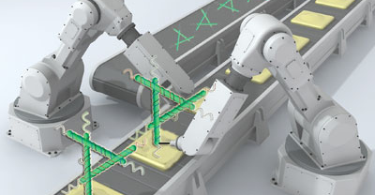
Factory
Create Objects

Slide 22
Factory
Examples for object creation?
Umm… each and every application?
Everyone knows how to create objects, right?
Right… we can do it so well, we construct objects just about everywhere
… which is a real disaster
Encapsulate class instantiation!
We strive to extend without modification (create new classes)
So we don’t want to have class instantiation all over our app!
Let’s sketch the idea…

Slide 23
Simple Factory

Slide 24
Factory method

Slide 25
Registry Factory

Slide 26
Plugin Manager (for Registry Factory)

Slide 27
Registry Factory – Stage 1

Slide 28

Decorator
Enrich Object & Keep Interface

Slide 29
Decorator
Examples of extending Object’s behavior/appearance?
Add logging to existing Object without modifying its Class
Decorate existing Widgets (i.e. add scroll bars etc.)
Clients of our Objects shouldn’t notice any difference
Except for some rare occasions (i.e. depending on concrete types). Remember
Therefore, a decorated (wrapped) Object should have the same interface as the original one
A flexible alternative to subclassing
Let’s sketch the idea… (déjà vu?)

Slide 30
Decorator

Slide 31
Decorator – Exercise
Context: OOPaint program from before
The Customer is happy with our product, and orders 3D effect feature. The User should be able to make a Shape (or a Group) appear 3D by clicking the Middle Mouse button over it.
Provide UML model (class diagram) and implementation for this functionality

Slide 32
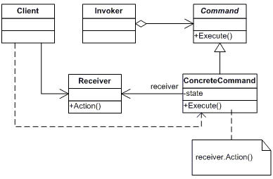
Command Pattern

Slide 33

Singleton
The One And Only

Slide 34
Singleton

Slide 35
Singleton
Advantages
Cannot create inadvertently more than one instance of a Class when it does not make sense (i.e. when that Class models exactly 1 real-world entity)
Makes use of lazy initialization where resources for the Singleton are only allocated the first time they are requested (compare to a global variable which allocates resource from program start)
Simplifies API by avoiding parameters solely dedicated to pass a single object around (Beware! See Disadvantages page)

Slide 36
Singleton
Disadvantages
Singletons represent a global state. Global state is transitive (it’s “contagious”) – i.e. it spreads wildly throughout the whole application
Singletons tend to spoil object-oriented design and style of implementation. Undermines encapsulation and loose coupling
Classes that use Singletons hide dependencies from the Singletons they use and from each other (their API is misleading)
As a result, the complexity of the system can easily increase out of control
There are multiple types of complexity Singletons bring (see the next page)

Slide 37
Singleton
Disadvantages (contd.)
Implementation complexity: Singletons easily can increase complexity by forcing you to take more things into consideration simultaneously while writing each line of code
As a consequence, the same code executed several times on the same input might lead to different results without obvious reasons (due to global state) – i.e. create a new object and call one of its methods with the same input: you expect the same output but it’s different
Unit test complexity: UT results are no longer reliable! Sometimes they pass, sometimes they fail because of (hidden) dependency on some global state
Debugging complexity: it’s harder to reproduce and debug a problem when it depends on some global state

Slide 38
Singleton
Challenging question to discuss
Singletons (being an object that encapsulates a global state) allow for two classes to interact without knowing about each other
Now, how is this a bad thing? Isn’t it what loose coupling?
(define what loose coupling really means)

Slide 39
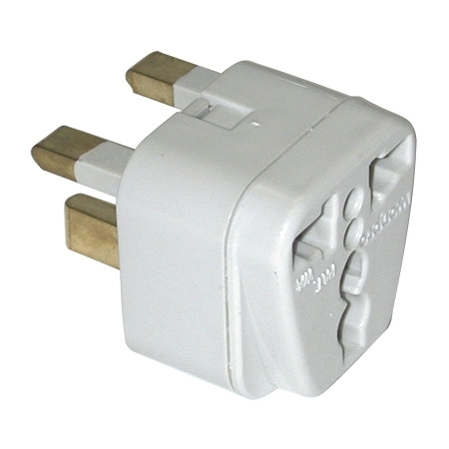
Adapter
“Things Are Not What They Appear”

Slide 40
Adapter

Slide 41
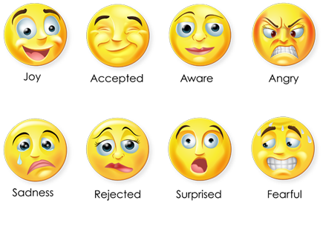
State
“I hope you are in a good mood”

Slide 42
State

Slide 43
State
But… it resembles Strategy a lot?
Differences
States know about the Context (store reference to it)
States can switch current State themselves (transition to other States)
States are created by the Context itself (Strategies are assigned to the Context from the outside)
States usually implement every Context operation

Slide 44
State – Exercise
Context: OOPaint program from before
Provide UML State diagram of UI flow
Provide UML model (class diagram) and implementation for this functionality

Slide 45
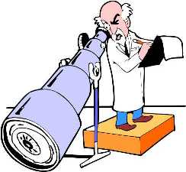
Observer
Publish-Subscribe

Slide 46
Observer

Slide 47
Observer
Roles & Responsibilities
Subject Interface – implemented by all classes that wish to become Subjects (to be Observed via publish/subscribe mechanism)
Observer Interface – implemented by all classes that wish to be Observers (to be able to subscribe for concrete Subjects and be notified on changes of their states)
Concrete Subjects– classes that need to act as Subjects (support subscriptions and notify all Observers that subscribe to them). Those classes need to have only 1 thing in common: they implement Subject Interface
Concrete Observers – classes that need to observe concrete Subjects. They are able to subscribe for notifications and receive such from the corresponding Subject

Slide 48
Observer
Dangers
Lapsed Listener Problem

Slide 49
Observer – Exercise
Context: OOPaint program from before
Customer wants a special graphic object (a “marker”) which if put on the Canvas, allows to move all graphic objects (like a caption) seemingly moving the whole Canvas around. A variant of that: move all graphic objects that are created after the marker.
Provide UML model (class diagram) and implementation for this functionality

Slide 50
Architectural Design Patterns
Software System Design

Slide 51

MVC
Model View Controller

Slide 52
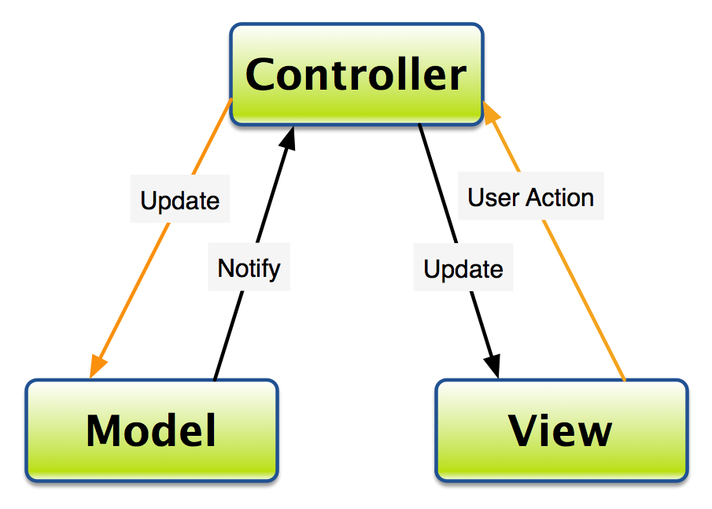
Model View Controller

Slide 53
References
Freeman, Eric, Elisabeth Robson, Bert Bates, Kathy Sierra (2004) Head First Design Patterns
http://misko.hevery.com/2008/11/21/clean-code-talks-global-state-and-singletons/

Slide 54

That’s All, Folks!

